Slide 1
Data Structure
Team Project
Team : 셋조 ( 서장원 안형진 신준영)
Notes:
http://minheeblog.tistory.com/category/PPT

Slide 2
CONTENTS
01 02 03 04 05
summary
Compare
Function
Execute
impression
- Program name
- Purpose of program
-Expected user
-pros and cons of the program
- Differentiation
- Expected value
- Function name
- description
-Execute video
- After completing this lesson
Review
Contribution
Notes:
http://minheeblog.tistory.com/category/PPT

Slide 3
SUMMARY
DATA STRUCTURE
01
Program Name
ATM
(A Travel Matcher)
Purpose of program
Can be updated every month(quarter)
Score the performance of the half or month
Use sort and gives bonus to each team.
Notes:
http://minheeblog.tistory.com/category/PPT

Slide 4
SUMMARY
DATA STRUCTURE
01
Expected User
People who need statistics of Uploaded files.
Ex) part time job manager, company manager
Pros and cons of the program
PROS :
Can read a lot of files , it can be constantly changed, not a fixed sort
Can be updated every month
CONS :
Have to upload a file
Notes:
http://minheeblog.tistory.com/category/PPT

Slide 5
COMPARE
DATA STRUCTURE
02
Differentiation
Differentiation vs Similar Programs
Similar Program : Excel program
This program can collect all the other files
and show in one Screen.
Notes:
http://minheeblog.tistory.com/category/PPT

Slide 6
COMPARE
DATA STRUCTURE
02
Expected Value in the future
Value in industry & anywhere?
Everywhere who needs to give bonus and match to the team
Can be used in all kind of industry of statistics, accounting
Notes:
http://minheeblog.tistory.com/category/PPT

Slide 7
FUNCTION
DATA STRUCTURE
03
Usage Function
1)Void Cal();
read a data from the file
2)Void data(int,int,int);
new data update
3)Void sort();
Using max heap sort about total point
4)Void dist(int);
give a bonus to each team which is sorted
5)Void dist_print();
print how much bonus each team has received
6)Void team();
Get a name of travel and get a preference of the travel spot to 160 people and sort to see the best travel spot. Use rand() to get the preference
Notes:
http://minheeblog.tistory.com/category/PPT

Slide 8
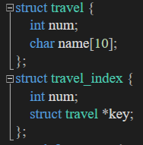
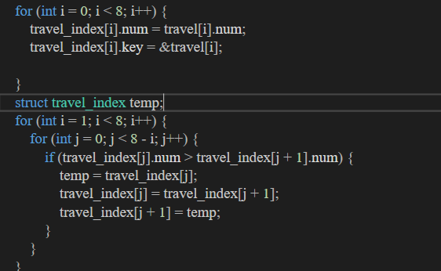
FUNCTION
DATA STRUCTURE
03
Usage Function
Notes:
http://minheeblog.tistory.com/category/PPT

Slide 9
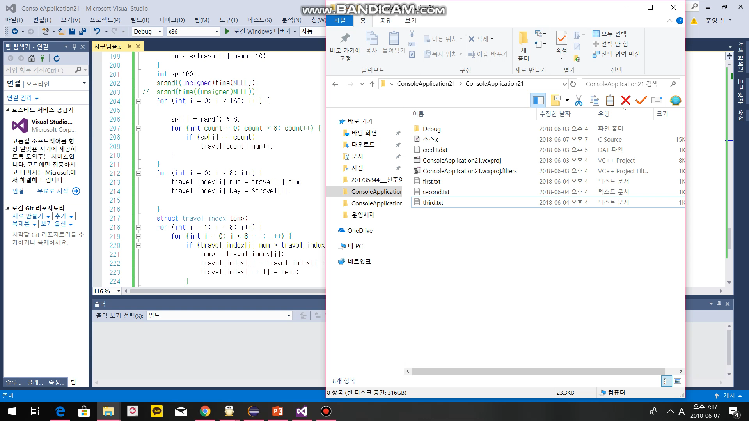
EXECUTE
DATA STRUCTURE
04
“ ”
Execution video
Notes:
http://minheeblog.tistory.com/category/PPT

Slide 10
IMPRESSION
DATA STRUCTURE
05
After completing this lesson
It helped a lot
Can learn and practice about lots of different sort algorithm
Team project Review
Had a hard time sorting
Good Teamwork
Cannot forget thrill of the compile success moment
Notes:
http://minheeblog.tistory.com/category/PPT

Slide 11
IMPRESSION
DATA STRUCTURE
05
“ ”
Contribution
Student ID | role | Contribution (%) | etc
201735839 서장원 | ppt product, Announcement | 33 | Travel coding
2017 안형진 | C coding, struct design | 33 | Overall coding
2017 신준영 | Program idea support | 33 | Sort coding
Notes:
http://minheeblog.tistory.com/category/PPT

Slide 12
DATA STRUCTURE
THANK
YOU
Notes:
http://minheeblog.tistory.com/category/PPT

